Slide 1
Introducing electricity load level detail into a CGE model
Renato Dias Bleasby Rodrigues
Pedro Linares Llamas

Slide 2
Contents
Motivation and objective
Modeling framework
Electricity Operation and Expansion Planning Model
CGE model
Electricity Technological disaggregated CGE
GEMED – General Equilibrium Model with Electricity Detail
Case study
Were do we go now?
Hybrid GEMED
Decomposed Hybrid GEMED
Conclusion

Slide 3
1
Motivation and Objective

Slide 4
Motivation and Objective:
Necessity for ex-ant assessments on energy policies with economy-wide consequences:
Cost benefit analysis, identification of economic agents affected, evaluation of technology alternatives, allocation of the economic burden, …
Take into account multiple production sectors and demanding agents
Have the electricity technological and production specific time behavior
Case study examples:
Active demand response
Elasticity evaluations
Electric vehicles as storage units
Renewable intermittence and reserve margin requirements
Transmission and distribution tariffs differentiated by consumption profile

Slide 5
Motivation and Objective:
Pure Top-down/Bottom-up estimation can be insufficient when there is meaningful:
technology switching;
specific and interchangeable operational costs;
time dependable decisions;…
and at the same time:
downstream and upstream sector interrelation;
necessity of an embodied energy analysis;
Inter-sector or inter-country leakage effects of policies;….
Primary objective: Surpass the limitations of a pure Top-down or Bottom-up modeling approach used in integrated energy-economic assessment analysis that requires both direct and indirect effects evaluations.
Top-down
Computable
General
Equilibrium
Model
Bottom-up
Electricity
operation and
Investment
model

Slide 6
2
Modeling framework

Slide 7
Modeling framework
Bottom-up Electricity Expansion Lineal Model (and MCP version)
Top-down Pure CGE Model (traditional or with technological disaggregation)
GEMED - Electricity Extended Top-down Pure CGE Model
load block, location and electricity producing technologies detail
SAM disaggregation model (to make compatible technological and statistical data)
Hybrid GEMED and Decomposed Hybrid GEMED
 | Direct sector related effects | Indirect economy wide effects
BU - electricity model | Very good | none
TD - CGE model | Very limited | good
TD - CGE with technology | Limited | good
TD - CGE with tech and time | Good | Very good
Hybrid model | Very good | Very good

Slide 8
General Equilibrium Model with Electricity Detail
What is the difference?
It still follows a CGE production function structure but:
Electricity is treated as a time heterogeneous commodity:
One electricity product for each different load level.
Electricity activity is disaggregated according regional transmission restrictions (zonal prices and different technologies portfolios).
Different load profiles represented for each one of the different electricity demanders.
Load block dependable generation technology portfolios, with disaggregated capital, labor, taxes and intermediary inputs expenses.
Representation of thermodynamic efficiency, technologies production capacity, overnight costs, construction time,… inserted into the CGE model as parameters.

Slide 9
GEMED: The electricity extended Social Accountability Matrix
Electricity
Generation |  |  |  |  |  |  | TD&O
Peninsular |  |  |  |  |  | NonPeninsular,…
Winter Holiday |  |  |  |  | Summer …
OffPeak |  |  | Medium Peak | …
Tech1 | Tech2 | … | Tech 1 | …
 | Manufactures | Coal | Oil-Nuclear | Gas | Electricity | Transport | Other_Services | LABOR | CAPITAL | Social_Contributions | CO2_Payments | Production_Taxes | Product_Tax | Households | Government | Saves-Investments | Exports
Manufactures | 396912,00 | 242,50 | 18083,90 | 4974,90 | 1965,80 | 6567,90 | 97333,20 |  |  |  |  |  |  | 110245,10 | 7032,80 | 134748,40 | 138267,70
Coal | 377,60 | 0,10 | 0,80 | 3,90 | 1903,80 | 4,70 | 73,50 |  |  |  |  |  |  | 34,20 | 0,00 | 14,10 | 4,70
Oil-Nuclear | 6214,00 | 30,10 | 5532,70 | 28,50 | 3072,40 | 6242,50 | 3093,30 |  |  |  |  |  |  | 7723,50 | 0,00 | 219,00 | 7483,20
Gas | 2011,30 | 0,10 | 3,90 | 0,60 | 3145,80 | 120,30 | 1077,50 |  |  |  |  |  |  | 1281,20 | 0,00 | 0,50 | 111,20
Electricity | 8962,70 | 88,40 | 72,50 | 28,60 | 5410,00 | 741,40 | 10537,90 |  |  |  |  |  |  | 6095,40 | 0,00 | 0,00 | 417,20
Transport | 24960,50 | 31,00 | 745,90 | 6,30 | 270,70 | 20638,80 | 14985,30 |  |  |  |  |  |  | 12053,70 | 1587,30 | 216,90 | 16093,40
Other_Services | 92784,10 | 99,70 | 1381,30 | 257,90 | 4772,70 | 12275,60 | 179882,00 |  |  |  |  |  |  | 354378,00 | 154625,70 | 42361,30 | 35433,60
Labor | 102997,00 | 301,10 | 390,60 | 197,80 | 1270,10 | 13024,50 | 216132,90
Capital | 101730,20 | 60,30 | 3226,60 | 2115,30 | 9098,70 | 16682,90 | 246069,00
Social_Contributions | 31093,40 | 96,30 | 130,40 | 71,00 | 504,60 | 3892,10 | 60626,20
CO2_Payments | 6175,92 | 29,72 | 446,24 | 283,94 | 2120,00 | 0,00 | 0,00
Production_Taxes | -4626,21 | -29,72 | -37,96 | -243,24 | 395,78 | 0,00 | 4651,80
Product_Tax | 149,40 | 19,20 | 624,70 | 26,80 | 0,00 | 2791,30 | 14087,20 |  |  |  |  |  |  | 54474,40 | 494,20 | 22591,80
Households |  |  |  |  |  |  |  | 334314,00 | 364051,00 |  |  |  |  | 0,00 | 100360,50
Government | -1549,71 | 0,00 | -331,38 | 0,00 | -2077,68 | 0,00 | 0,00 | 0,00 | 14932,00 | 96414,00 | 9055,83 | 110,44 | 95259,00 | 98697,00 | 0,00
Saves-Investments |  |  |  |  |  |  |  |  |  |  |  |  |  | 153743,00 | 46409,00
Imports | 148182,00 | 1448,60 | 9369,00 | 0,10 | 501,40 | 8607,80 | 29702,10
 | Activity | Location | Period | Load Block
Electricity | Generation | Peninsular | Winter Holiday | OffPeak
 |  |  |  | Medium
 |  |  |  | Peak
 |  |  | Summer,…
 |  | NonPeninsular,…
 | TD&O | …

Slide 10
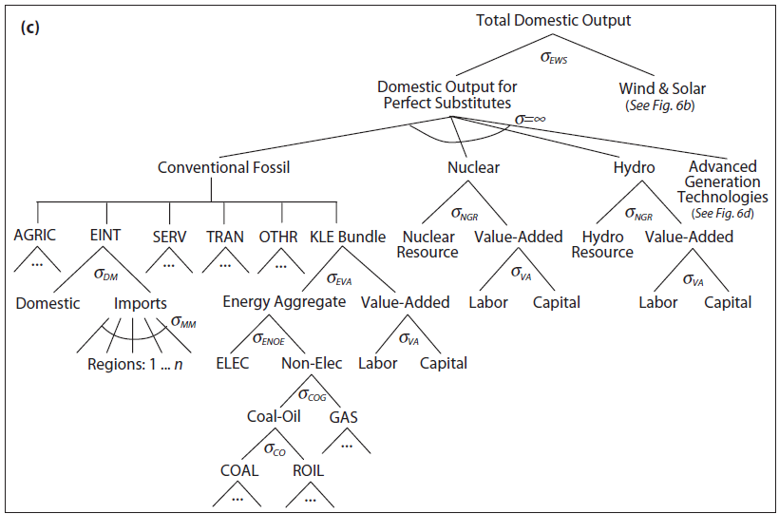
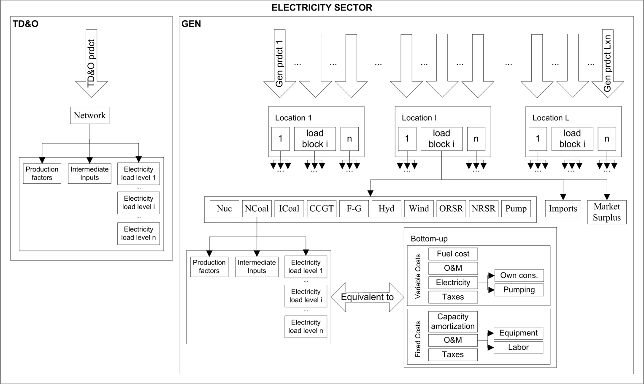
GEMED: The production structure

Slide 11
GEMED: How do we do it?
Identify costs in the BU model and associated parameters:
CGE
power generation operation and expansion
Cost type | Associated technology parameters
Fuel | Thermodynamic efficiency, generated power, fuel price
Variable O&M | Variable O&M costs by technology, generated power
Fixed O&M | Fixed O&M costs by technology, installed capacity
Capital | Overnight costs, construction time, years of amortization, real discount rate, interest rate , installed capacity
Labor | labor use by technology, installed capacity, social contributions
Taxes | Direct and indirect taxes, renewable subsidies,…
Own consumption | electricity own consumption by technology, electricity price
Losses | electricity losses in the grid, electricity price
Pumping | pumping efficiency an generated power, electricity price

Slide 12
GEMED: How do we do it?
Fixed costs, non accounted costs and market failures distribution by load blocks:
p
Fixed costs:
Annual O&M; installed capacity amortization;
new capacity installation;…
Non accounted costs:
Ramp and Startup costs;…
Market failures:
Presence of non competitive market power rents.
CCGT
Fuel oil
Carbon
Nuclear
q
p
CCGT
Fuel oil
Carbon
Nuclear
q

Slide 13
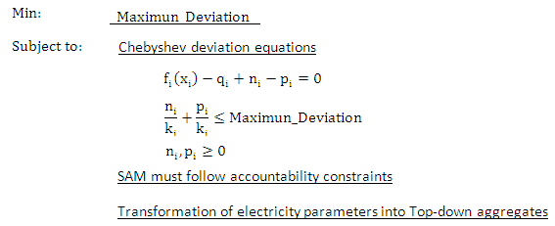
GEMED: How do we do it?
power generation operation and expansion
Electricity prices
Fixed costs distribution by load blocks
Non accounted costs and market imperfections rents
Min Max Deviation
Extended SAM
with technology and load block disaggregation
Adjusted technology parameters
Notes:
Approximate the technological parameters to reflect the Top-down aggregate

Slide 14
3
Case Study

Slide 15
Case study: Household Demand Response Simulation
Household active demand response potential savings in Spain
Consumption variation with ADR
Appliance | Displacement | Reduction | ADR actions
Washing machine | 100% | 40% | Full shutdown
Dishwasher | 100% | 40% | ECO program
Dryer | 100% | 20% | Limitations
Water heating | 50% | 30% | stop / partial shutdown
Heating | - | 50% | Unacceptable shutdown
Air-conditioner | - | 50% | Power limitations, thermostat, time zones ...
Others | - | - | Non manageable

Slide 16
Case study: Household Demand Response Simulation
Active demand response demand balance:
$${\overline{demand}}_{y,l,p,b}+{INCREASED_DR_LOAD}_{y,l,p,b}−{DECREASED_DR_LOAD}_{y,l,p,b}−{CONSERVED_DR_LOAD}_{y,l,p,b}≤\sum_{t,f}{{PGEN}_{y,t,f,l,p,b}}+{\overline{pimp}}_{y,l,p,b}−{PPUMPED}_{y,l,p,b}−\left(\overline{own_cons}\right)\sum_{t,f}{{PGEN}_{y,t,f,l,p,b}}−{\overline{loss}}_{y,l,p,b}\left(\sum_{t,f}{{PGEN}_{y,t,f,l,p,b}}+{\overline{pimp}}_{y,l,p,b}+{\overline{pexp⁡}}_{y,l,p,b}−{PPUMPED}_{y,l,p,b}\right)$$
Maximum displacement:
$${DECREASED_DR_LOAD}_{y,l,p,b}≤{\overline{displaceable_load}}_{y,l,p,b}$$
Displacement balance:
$$\sum_{b}{\left({INCREASED_DR_LOAD}_{y,l,p,b}{\overline{dur}}_{l,p,b}\right)}=\sum_{b}{\left({DECREASED_DR_LOAD}_{y,l,p,b}{\overline{dur}}_{l,p,b}\right)}$$
Potency conservation limit:
$${CONSERVED_DR_LOAD}_{y,l,p,b}≤{\overline{conservable_load}}_{y,l,p,b}$$
Minimal savings requirement:
$$\sum_{b}{\left({DECREASED_DR_LOAD}_{y,l,p,b}{\overline{gad_price}}_{y,l,p,b}{\overline{dur}}_{l,p,b}\right)}−\sum_{b}{\left({INCREASED_DR_LOAD}_{y,l,p,b}{\overline{gad_price}}_{y,l,p,b}{\overline{dur}}_{l,p,b}\right)}≤\left(1−\overline{min⁡_sav}\right)\sum_{b}{\left({\overline{displaceable_load}}_{y,l,p,b}{\overline{gad_price}}_{y,l,p,b}{\overline{dur}}_{l,p,b}\right)}$$

Slide 17
Demand Response: BU vs. CGE with electricity detail vs. GEMED
 |  |  | BAU | BU DR counterfactual simulation |  |  |  | Difference
 |  | Scenario | Total income (10⁶ €) | Total income (10⁶ €) (%) | Price (€/MWh) (%) | Quantity (GW) (%) | Emissions (%) | Final consumer savings (10⁶ €)
Bottom-up | Electricity Model | 1 Load block | 13,138 | 12,903 (-1.79%) | 52.84 (0.00%) | 244,152 (-1,79%) | -1.80%CO₂ e -0.52%Acid e | 235
 |  | 12 Load blocks | 15,867 | 14,190 (-10.57%) | 58.19 (-8.83%) | 243,865 (-1.91%) | -2.42%CO₂ e -0.82%Acid e | 1,677
 |  | 75 Load blocks | 16,490 | 14,433 (-12.48%) | 59.25 (-10.65%) | 243,586 (-2,04%) | -2.72%CO₂ e -0.95%Acid e | 2,057
 |  | 210 Load blocks | 16,605 | 14,224 (-14.34%) | 58,49 (-12,41%) | 243,194 (-2,20%) | -2.90%CO₂ e -1.01%Acid e | 2,381
Top-down CGE | Tech. disaggregated CGE (1 LB and nested CES electricity techs) (Similar to EPPA Model: Version 4) |  | 13,060 | 12,847 (-1.64%) | 52.84 (0.00%) | 243,068 (-1.64%) | -1.64% CO₂ e -1.64% Acid e | 213
 | GEMED (tech and time disaggregation) | 12 Load blocks | 15,141 | 14,859 (-1.86%) | 61.23 (-0.06%) | 242,684 (-1.80%) |  | 282
 |  | 75 load blocks | 15,538 | 15,226 (-2.01%) | 62.81 (-0.07%) | 242,399 (-1.94%) |  | 312
 |  | 210 load blocks | 15,613 | 15,238 (-2.40%) | 63.03 (-0.21%) | 241,762 (-2.20%) |  | 375

Slide 18
Demand Response: BU vs. CGE with electricity detail vs. GEMED
 |  |  | BAU | BU DR counterfactual simulation |  |  |  | Difference
 |  | Scenario | Total income (10⁶ €) | Total income (10⁶ €) (%) | Price (€/MWh) (%) | Quantity (GW) (%) | Emissions (%) | Final consumer savings (10⁶ €)
Bottom-up | Electricity Model | 1 Load block | 13,138 | 12,903 (-1.79%) | 52.84 (0.00%) | 244,152 (-1,79%) | -1.80%CO₂ e -0.52%Acid e | 235
 |  | 12 Load blocks | 15,867 | 14,190 (-10.57%) | 58.19 (-8.83%) | 243,865 (-1.91%) | -2.42%CO₂ e -0.82%Acid e | 1,677
 |  | 75 Load blocks | 16,490 | 14,433 (-12.48%) | 59.25 (-10.65%) | 243,586 (-2,04%) | -2.72%CO₂ e -0.95%Acid e | 2,057
 |  | 210 Load blocks | 16,605 | 14,224 (-14.34%) | 58,49 (-12,41%) | 243,194 (-2,20%) | -2.90%CO₂ e -1.01%Acid e | 2,381
Top-down CGE | Tech. disaggregated CGE (1 LB and nested CES electricity techs) (Similar to EPPA Model: Version 4) |  | 13,060 | 12,847 (-1.64%) | 52.84 (0.00%) | 243,068 (-1.64%) | -1.64% CO₂ e -1.64% Acid e | 213
 | GEMED (tech and time disaggregation) | 12 Load blocks | 15,141 | 14,859 (-1.86%) | 61.23 (-0.06%) | 242,684 (-1.80%) |  | 282
 |  | 75 load blocks | 15,538 | 15,226 (-2.01%) | 62.81 (-0.07%) | 242,399 (-1.94%) |  | 312
 |  | 210 load blocks | 15,613 | 15,238 (-2.40%) | 63.03 (-0.21%) | 241,762 (-2.20%) |  | 375

Slide 19
Demand Response: BU vs. CGE with electricity detail vs. GEMED
 |  |  | BAU | BU DR counterfactual simulation |  |  |  | Difference
 |  | Scenario | Total income (10⁶ €) | Total income (10⁶ €) (%) | Price (€/MWh) (%) | Quantity (GW) (%) | Emissions (%) | Final consumer savings (10⁶ €)
Bottom-up | Electricity Model | 1 Load block | 13,138 | 12,903 (-1.79%) | 52.84 (0.00%) | 244,152 (-1,79%) | -1.80%CO₂ e -0.52%Acid e | 235
 |  | 12 Load blocks | 15,867 | 14,190 (-10.57%) | 58.19 (-8.83%) | 243,865 (-1.91%) | -2.42%CO₂ e -0.82%Acid e | 1,677
 |  | 75 Load blocks | 16,490 | 14,433 (-12.48%) | 59.25 (-10.65%) | 243,586 (-2,04%) | -2.72%CO₂ e -0.95%Acid e | 2,057
 |  | 210 Load blocks | 16,605 | 14,224 (-14.34%) | 58,49 (-12,41%) | 243,194 (-2,20%) | -2.90%CO₂ e -1.01%Acid e | 2,381
Top-down CGE | Tech. disaggregated CGE (1 LB and nested CES electricity techs) (Similar to EPPA Model: Version 4) |  | 13,060 | 12,847 (-1.64%) | 52.84 (0.00%) | 243,068 (-1.64%) | -1.64% CO₂ e -1.64% Acid e | 213
 | GEMED (tech and time disaggregation) | 12 Load blocks | 15,141 | 14,859 (-1.86%) | 61.23 (-0.06%) | 242,684 (-1.80%) |  | 282
 |  | 75 load blocks | 15,538 | 15,226 (-2.01%) | 62.81 (-0.07%) | 242,399 (-1.94%) |  | 312
 |  | 210 load blocks | 15,613 | 15,238 (-2.40%) | 63.03 (-0.21%) | 241,762 (-2.20%) |  | 375

Slide 20
Demand Response: BU vs. CGE with electricity detail vs. GEMED
 |  |  | BAU | BU DR counterfactual simulation |  |  |  | Difference
 |  | Scenario | Total income (10⁶ €) | Total income (10⁶ €) (%) | Price (€/MWh) (%) | Quantity (GW) (%) | Emissions (%) | Final consumer savings (10⁶ €)
Bottom-up | Electricity Model | 1 Load block | 13,138 | 12,903 (-1.79%) | 52.84 (0.00%) | 244,152 (-1,79%) | -1.80%CO₂ e -0.52%Acid e | 235
 |  | 12 Load blocks | 15,867 | 14,190 (-10.57%) | 58.19 (-8.83%) | 243,865 (-1.91%) | -2.42%CO₂ e -0.82%Acid e | 1,677
 |  | 75 Load blocks | 16,490 | 14,433 (-12.48%) | 59.25 (-10.65%) | 243,586 (-2,04%) | -2.72%CO₂ e -0.95%Acid e | 2,057
 |  | 210 Load blocks | 16,605 | 14,224 (-14.34%) | 58,49 (-12,41%) | 243,194 (-2,20%) | -2.90%CO₂ e -1.01%Acid e | 2,381
Top-down CGE | Tech. disaggregated CGE (1 LB and nested CES electricity techs) (Similar to EPPA Model: Version 4) |  | 13,060 | 12,847 (-1.64%) | 52.84 (0.00%) | 243,068 (-1.64%) | -1.64% CO₂ e -1.64% Acid e | 213
 | GEMED (tech and time disaggregation) | 12 Load blocks | 15,141 | 14,859 (-1.86%) | 61.23 (-0.06%) | 242,684 (-1.80%) |  | 282
 |  | 75 load blocks | 15,538 | 15,226 (-2.01%) | 62.81 (-0.07%) | 242,399 (-1.94%) |  | 312
 |  | 210 load blocks | 15,613 | 15,238 (-2.40%) | 63.03 (-0.21%) | 241,762 (-2.20%) |  | 375

Slide 21
Demand Response: BU vs. CGE with electricity detail vs. GEMED
 |  |  | BAU | BU DR counterfactual simulation |  |  |  | Difference
 |  | Scenario | Total income (10⁶ €) | Total income (10⁶ €) (%) | Price (€/MWh) (%) | Quantity (GW) (%) | Emissions (%) | Final consumer savings (10⁶ €)
Bottom-up | Electricity Model | 1 Load block | 13,138 | 12,903 (-1.79%) | 52.84 (0.00%) | 244,152 (-1,79%) | -1.80%CO₂ e -0.52%Acid e | 235
 |  | 12 Load blocks | 15,867 | 14,190 (-10.57%) | 58.19 (-8.83%) | 243,865 (-1.91%) | -2.42%CO₂ e -0.82%Acid e | 1,677
 |  | 75 Load blocks | 16,490 | 14,433 (-12.48%) | 59.25 (-10.65%) | 243,586 (-2,04%) | -2.72%CO₂ e -0.95%Acid e | 2,057
 |  | 210 Load blocks | 16,605 | 14,224 (-14.34%) | 58,49 (-12,41%) | 243,194 (-2,20%) | -2.90%CO₂ e -1.01%Acid e | 2,381
Top-down CGE | Tech. disaggregated CGE (1 LB and nested CES electricity techs) (Similar to EPPA Model: Version 4) |  | 13,060 | 12,847 (-1.64%) | 52.84 (0.00%) | 243,068 (-1.64%) | -1.64% CO₂ e -1.64% Acid e | 213
 | GEMED (tech and time disaggregation) | 12 Load blocks | 15,141 | 14,859 (-1.86%) | 61.23 (-0.06%) | 242,684 (-1.80%) |  | 282
 |  | 75 load blocks | 15,538 | 15,226 (-2.01%) | 62.81 (-0.07%) | 242,399 (-1.94%) |  | 312
 |  | 210 load blocks | 15,613 | 15,238 (-2.40%) | 63.03 (-0.21%) | 241,762 (-2.20%) |  | 375

Slide 22
4. GEMED - General Equilibrium Model with Electricity Detail
Verdict on the GEMED model:
Good at:
Capable of addressing displacement effects, and consequently much better quantities representation.
Indirect effects evaluation enriched by agents electricity load profiles representation.
Much better representation of technologies portfolio choices, and consequently better representation of fuel and other suppliers policy consequences.
Bad at:
Technological substitution and backstop technologies still limited by the production function structure.
Direction of marginal settlement prices better represented however their magnitude is still highly underestimated because the lack of expensive peak unit technologies retirement.

Slide 23
4
Were do we go now?

Slide 24
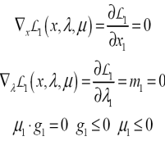
Hybrid GEMED:
Completely integrated mixed complementarity hard-link hybrid TD-BU model.
Productive
Sectors
International
Aggregations
Households
Government
Optimization
sector 1
Optimization
sector j
Optimization
sector n
Europe
Rest of the
World
Welfare
Optimization
Budget
Constraint
…
…
Electricity
sector model
Market clearing conditions

Slide 25
Decomposed Hybrid GEMED
The Hybrid model adds complexity in number of variables and equations.
Work around:
Decompose the electricity investment decision (or even the entire electricity production decision) from the Hybrid GEMED model using benders decomposition or similar solution space constraint techniques.
Research is currently under way to determine feasibility, calibration procedures, equation formulations and decomposition techniques for such a model, and in particular, to using it in a real-world setting.
How it is different from the iterative process of solving a bottom-up model and feeding the Top-down model with its results until a convergence is reached.
It is based on making optimal cuts to the feasible region of the master problem, what gives a much more robust result without underestimating the indirect effects consequences (avoiding the rabbit-and-elephant analogy).
Not only prices are sent and quantities are received as in most of the iterative model solutions using CGE and Bottom-up models. Dual and primal information are shared between models.

Slide 26
5
Conclusions

Slide 27
Conclusions: (1/4)
Electricity technology detail in CGE models can be insufficient to address specific electricity issues such as:
Active demand response potential;
Electric vehicles impacts;
Demand, price and cross elasticity evaluations;
Environmental effects, carbon tax, electricity tariffs, fuel subsidies,…
We presented the first attempt to our knowledge at building temporal disaggregation into a CGE model, while keeping technological detail. The GEMED model is capable of addressing:
Time differentiation at the electricity level reflecting:
electricity load block approximated marginal prices behavior;
distribution of capital amortization and fixed costs payments between different load blocks;
market power rents and other sources of costs represent at the aggregated national accountability data of the electricity sector.
Electricity generation technology detail
Location specific detail,…

Slide 28
Conclusions: (2/4)
A calibration method was developed to reconcialiate the large amount of bottom-up parameters details to either a CGE model with electricity load blocks and technologies detail and also to a completely integrated hybrid Top-down CGE and Bottom-up electricity operation and planning model.
The addition of load block disaggregation allowed the CGE model to assess endogenously the effects of load shifts, impossible to represent under a single load block assumption.
The resulting TD model mimics the rich description of the electricity sector production decisions present in the BU electricity models without overlooking the indirect effects and inter-sectorial and institutional consequences of the energy policies.

Slide 29
Conclusions: (3/4)
This improved representation of electricity activity enriches the evaluation of indirect and rebound effects by the CGE modeling approach. The direct consequence of such extension is a better representation of the policy consequences on other sectors, most specially fuel suppliers and high capital demanders .
In addition, we have shown the feasibility of applying the GEMED model to:
A real-world policy assessment, the assessment of a household demand response program;
A real-world economy and all dimensionalities problems associated with that.
The case study took into account the actual Spanish electricity facilities and technology availability, the operation and future investments decision, and the national accounting data of the Spanish economy.
The presence of distinct electricity markets with different market structures and conditions (the peninsular and the extra-peninsular Spanish markets).

Slide 30
Conclusions: (4/4)
Nevertheless, the results obtained by this work are still susceptible to improvements.
The CGE statistical production function structure limits the representation of important market dynamics effects like:
the retirement of non competitive technologies;
the inclusion of backstop technologies;
The representation of start-up costs;
the simulation of penetration and consequences of intermittent sources.
Developing a completely integrated mixed complementarity hard-link hybrid TD-BU model and a decomposed hybrid model are the normal path improvements for such policy assessments.

Slide 31
?
Thank you for your attention!
Questions and comments are welcome!
Contact info: renato.rodrigues@iit.upcomillas.es
http://www.iit.upcomillas.es/rdias/

Slide 32
References
RODRIGUES, R.; PEDRO, L.. Introducing electricity load level detail into a CGE model – The GEMED model. Under review in Energy Economics. July, 2012.
RODRIGUES, R.; PEDRO, L.. GEMED report version 0.1. http://www.iit.upcomillas.es/rdias/Static_GEMED.html

